Slide 1
Generate BBH Initial Data Using Physics Informed DeepONet (PIDONet)
Hilary Wu
Y.-C. Zhou et al., “Solving Hamiltonian Constraint Equation with Physics-Informed Neural Networks,” Phys. Rev. D, Jun. 2026, doi: 10.1103/619s-p6md.
C. O. Lousto and Y. Zlochower, ‘Foundations of multiple black hole evolutions’, Phys. Rev. D, vol. 77, no. 2, p. 024034, Jan. 2008, doi: 10.1103/PhysRevD.77.024034.
G. B. Cook, ‘Initial Data for Numerical Relativity’, Living Rev. Relativ., vol. 3, no. 1, p. 5, Dec. 2000, doi: 10.12942/lrr-2000-5.
L. Lu, P. Jin, G. Pang, Z. Zhang, and G. E. Karniadakis, ‘Learning nonlinear operators via DeepONet based on the universal approximation theorem of operators’, Nat Mach Intell, vol. 3, no. 3, pp. 218–229, Mar. 2021, doi: 10.1038/s42256-021-00302-5.
S. Wang, H. Wang, and P. Perdikaris, ‘Learning the solution operator of parametric partial differential equations with physics-informed DeepOnets’, Mar. 19, 2021, arXiv: arXiv:2103.10974. doi: 10.48550/arXiv.2103.10974.
Notes:
First paper: project idea
Second paper: Underlying mathematics
Third paper: Background physics
Fourth paper: DeepONet
Fifth paper: PIDONet

Slide 2
Issues with Physics Informed FNO
FNO requires Fourier transforming an entire grid of data
TwoPunctures generate data in a spherical domain
Some datapoints are removed to be used for validation
Trained PINO can only predict correction field for a rectangular domain
Cannot validate against individual points or test against a spherical domain
Cannot generate high-resolution datasets due to memory constraints
TwoPunctures can generate datasets in 1D or 2D domains

Slide 3

Theory
Einstein’s Field Equations:
$$G_{μν}=8πGT_{μν}$$
Hamiltonian Constraint Equation:
$$Δu+\frac{1}{8}{\left(1+\sum_{n}{\frac{m_{n}}{2r_{n}}}+u\right)}^{−7}{\overline{K}}_{ij}{\overline{K}}^{ij}=0$$
Notes:
G: Einstein Tensor
T: Stress-energy tensor due to matter and radiation
10 PDEs
4 spatial evolution equations
6 constraint equations
Conformal decomposition
u: Regular correction to the singular analytic part of the conformal factor, represents the additional nonlinear deformation of the spatial geometry caused by the combined binary configuration, particularly the black holes’ momenta and spins
m: mass of the blackholes
r: distance from the punctures
K: Trace-free extrinsic curvature, measures how the spatial hypersurface is embedded in spacetime, contains momenta and spin of the system

Slide 4
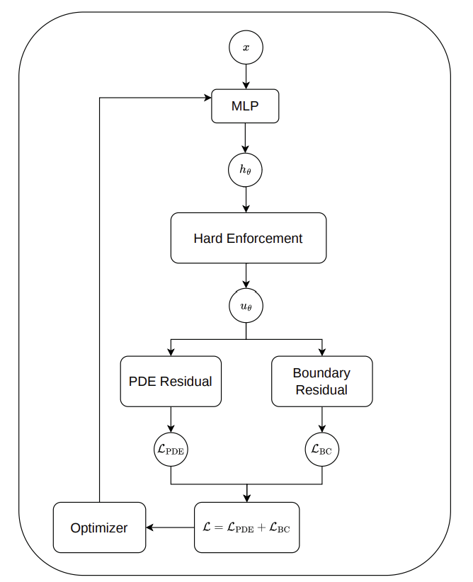

Slide 5

Loss function
$ℒ=w_{2}L_{2}+w_{∞}$soft-$L_{∞}+w_{rob}ℒ_{BC}$
$$L_{2}∼{10}^{−8}−{10}^{−11}$$
soft-$L_{∞}∼{10}^{−5}$
$$ℒ_{BC}∼{10}^{−12}$$
Notes:
log sum exponential form of L_inf loss

Slide 6

Exponential Moving Average (EMA) method
$${\overline{L}}_{k}\left(t_{n}\right)=α{\overline{L}}_{k}\left(t_{n−1}\right)+\left(1−α\right)L_{k}\left(t_{n}\right)$$
$L_{k}=\{L_{2},$soft-$L_{∞},ℒ_{BC}\}$
$α∈\left[0,1\right)$, chosen to be 0.99
$$\overset{˜}{L}\left(t_{n}\right)=\frac{L_{k}\left(t_{n}\right)}{{\overline{L}}_{k}\left(t_{n}\right)}$$
Notes:
100 epoch effective window for optimisaiton

Slide 7
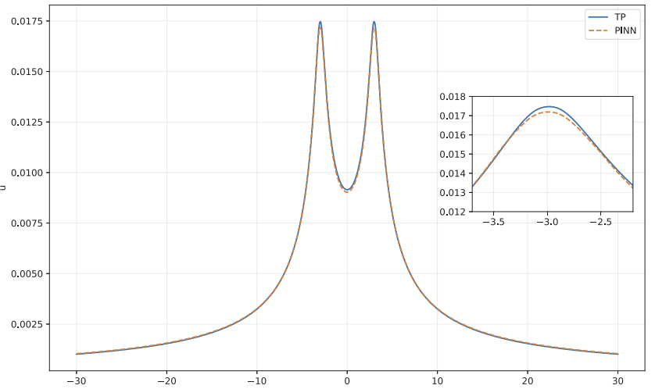
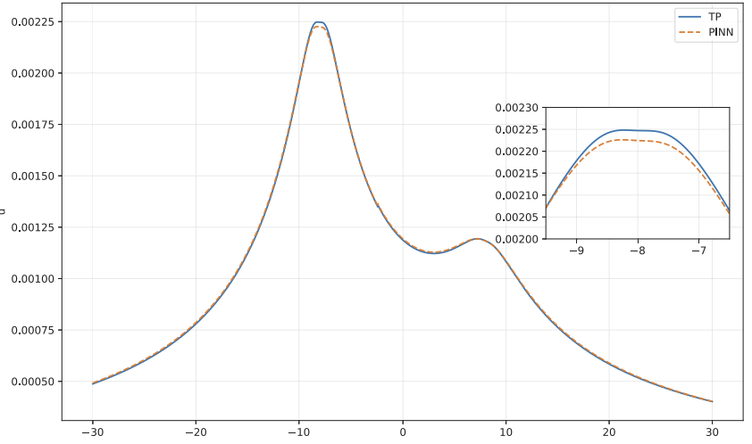


Paper Results
$$\text{L2RE}=0.0172±0.0040$$
$$\text{L2RE}=0.0077±0.0007$$
Notes:
m = +-0.5
x = +- 3
P = +-0.2
m+ = 3
m- = 2
x = +-8
Px+ = 0.1
Py+ = 0.25
Px- = 0.2
Py- = -0.25

Slide 8
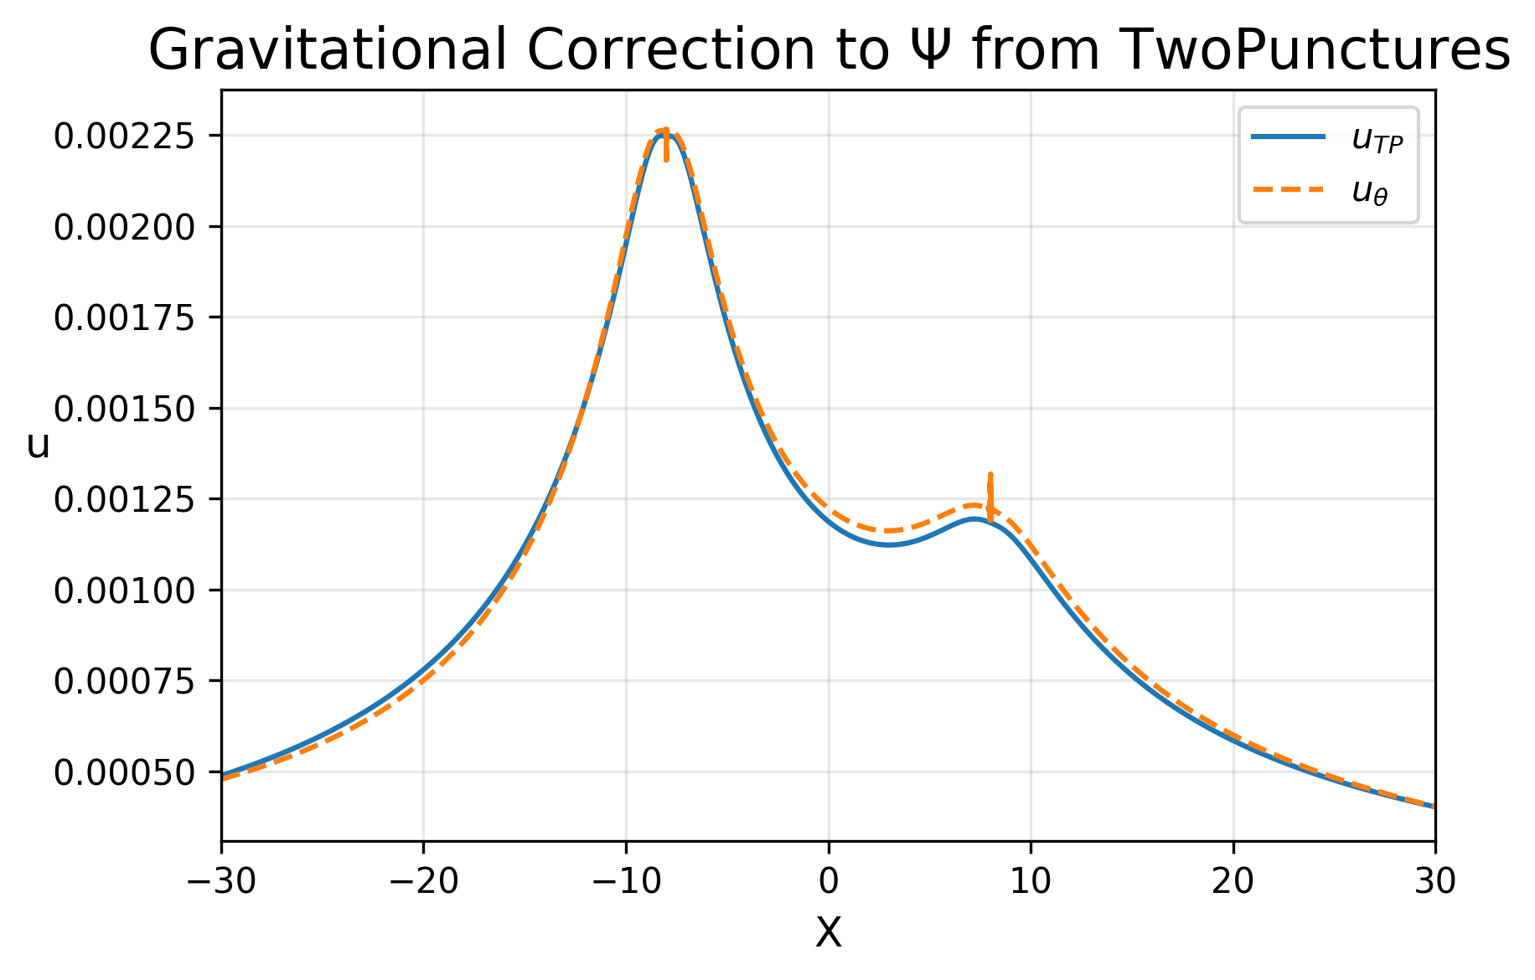
First attempt
Notes:
Accurate prediction for m-
Less accurate prediction for m+
Spikes at immediate surrounding around punctures

Slide 9
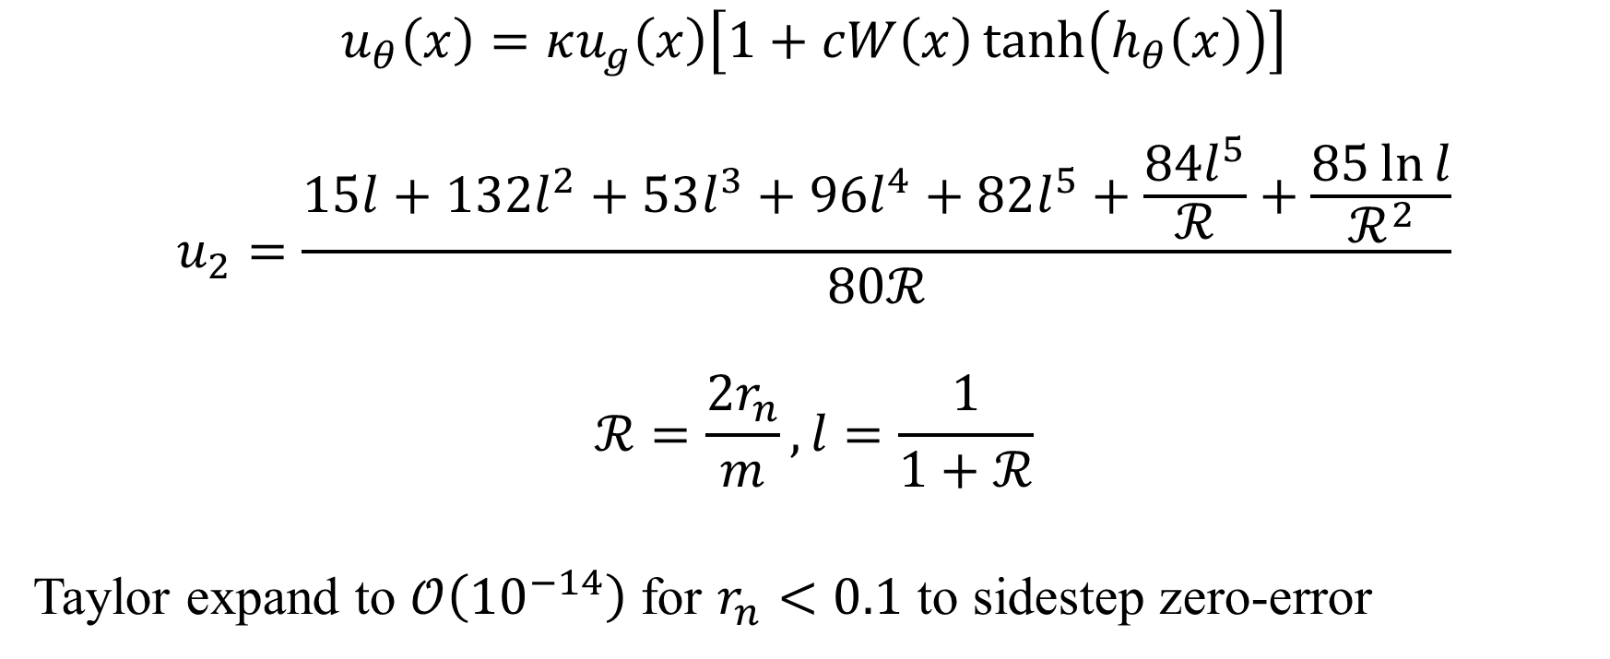
Ansatz
$$u_{θ}\left(x\right)=κu_{g}\left(x\right)\left[1+cW\left(x\right)\tanh\left(h_{θ}\left(x\right)\right)\right]$$
$$u_{2}=\frac{15l+132l^{2}+53l^{3}+96l^{4}+82l^{5}+\frac{84l^{5}}{ℛ}+\frac{85\ln{l}}{ℛ^{2}}}{80ℛ}$$
$$ℛ=\frac{2r_{n}}{m},l=\frac{1}{1+ℛ}$$
Taylor expand to $𝒪\left({10}^{−14}\right)$ for $r_{n}<0.1$ to sidestep zero-error
Notes:
ug = approximate analytic solution
contains u2
denominator contains curly R

Slide 10
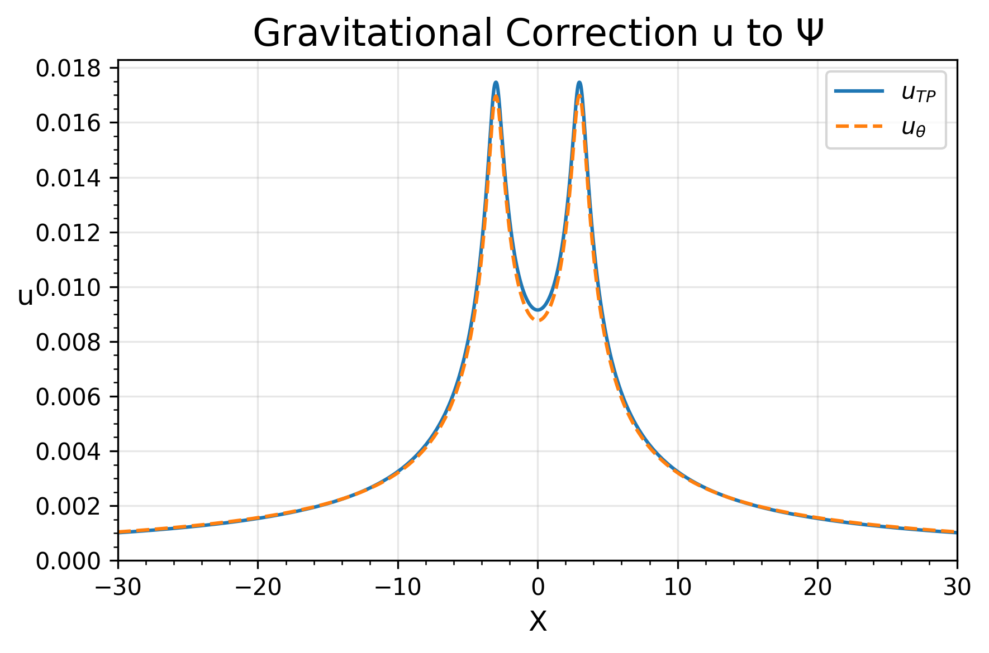
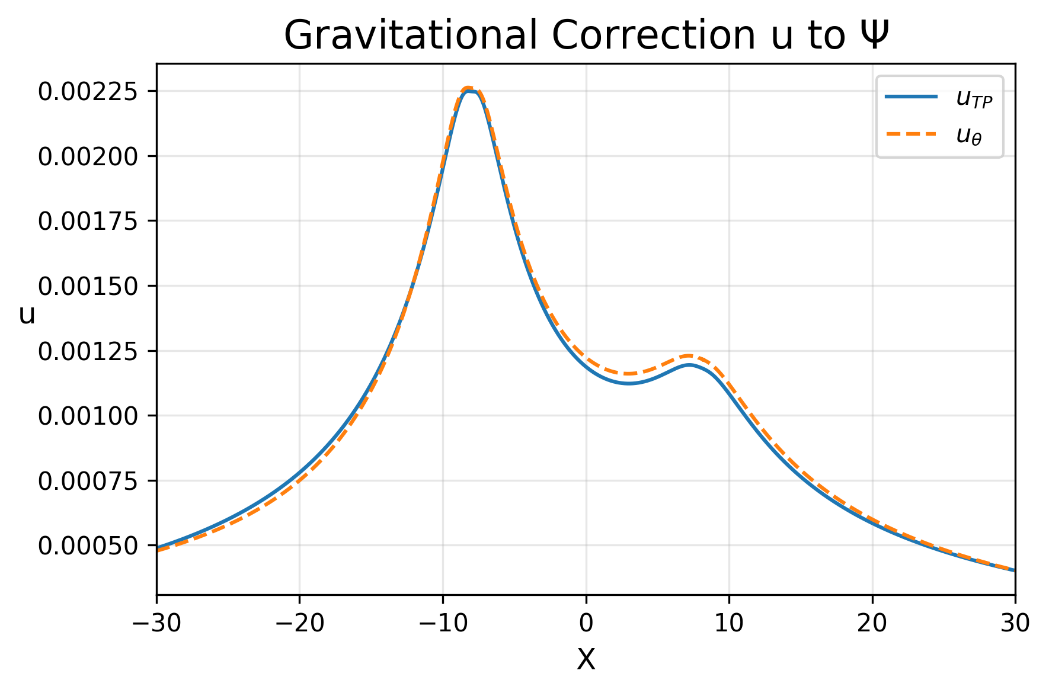


Second attempt
$$L2RE=0.028$$
$$L2RE=0.048$$
Notes:
Equal mass case:
systematically underestimates u around and inbetween punctures
Unequal mass case:
More accurate prediction near lower mass blackhole.
Less accurate for lower values of u

Slide 11
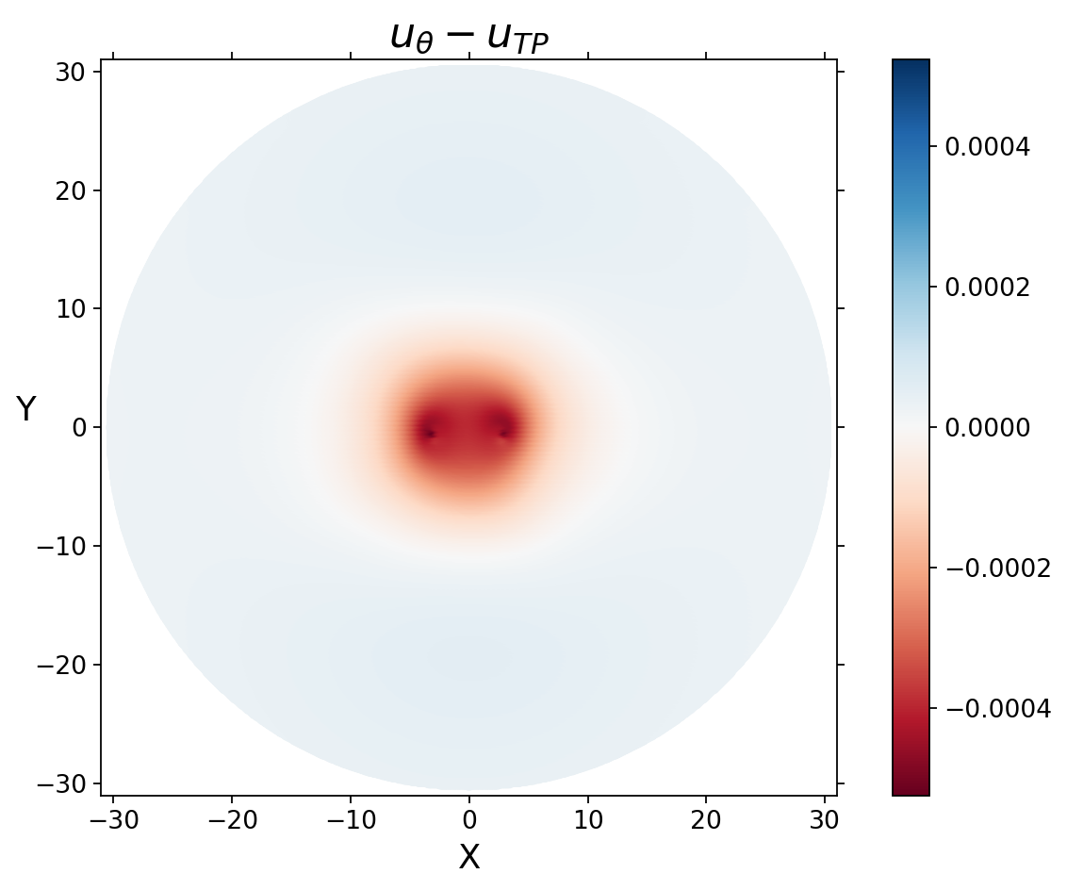
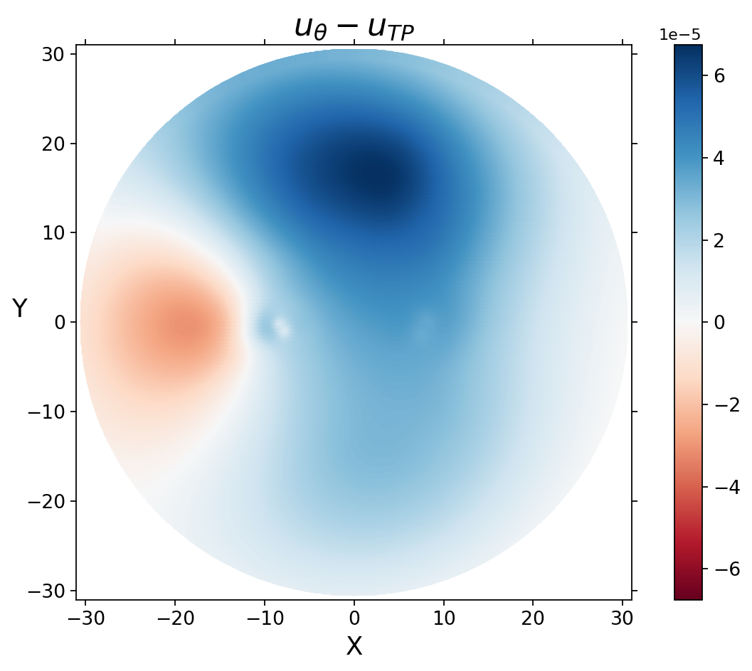
In XY-plane
Notes:
Equal mass case:
deviation mainly from central region around the punctures
Unequal mass case:
Largest deviation from positive y region away from the punctures
Maybe due to loss collocation points near that region

Slide 12
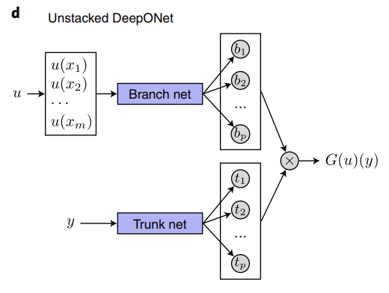

DeepONet Recap
$$G\left(u\right)\left(y\right)=\sum_{k=1}^{p}{b_{k}}t_{k}+b_{0}$$
Notes:
Branch net encodes discrete input function space
Trunk net encodes domain of output function G
Calculate G using dot product of branch and trunk net outputs and a optimised bias term

Slide 13
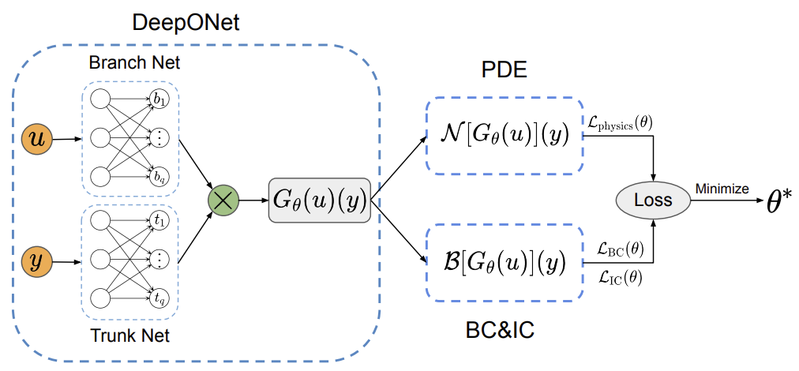
Physics Informed DeepONet (PIDONet)
Notes:
Extends DeepONet by taking into account PDE residual and IC, BC loss

Slide 14
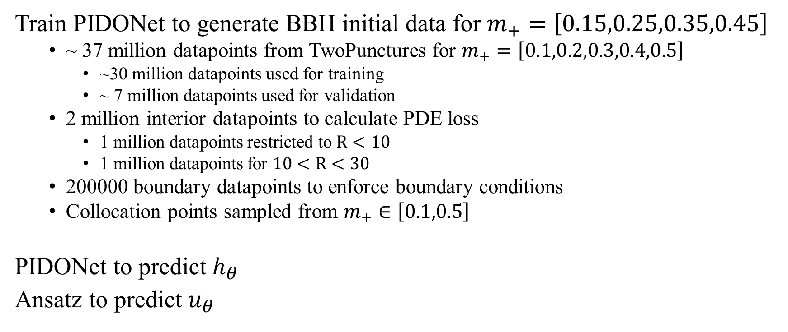
Project Plan
Train PIDONet to generate BBH initial data for $m_{+}=\left[0.15,0.25,0.35,0.45\right]$
~ 37 million datapoints from TwoPunctures for $m_{+}=\left[0.1,0.2,0.3,0.4,0.5\right]$
~30 million datapoints used for training
~ 7 million datapoints used for validation
2 million interior datapoints to calculate PDE loss
1 million datapoints restricted to $R<10$
1 million datapoints for $10<R<30$
200000 boundary datapoints to enforce boundary conditions
Collocation points sampled from $m_{+}∈\left[0.1,0.5\right]$
PIDONet to predict $h_{θ}$
Ansatz to predict $u_{θ}$

Slide 15

Operator Training Architecture
Branch net input:
$b_{k}=[m_{+},m_{−},x_{+},y_{+},z_{+},x_{−},y_{−},z_{−},P_{x+},P_{y+},P_{z+},P_{x−},P_{y−},P_{z−}]$
$m_{+}+m_{−}=1$
$X_{+}=\left[3,0,0\right]$, $X_{−}=\left[−3,0,0\right]$
$P_{y+}=0.8×m_{+}×m_{−}$, $P_{y+}=−P_{y−}$, $P_{x+}=P_{z+}=P_{x−}=P_{z−}=0$
Trunk net input:
$t_{k}=\left[x,y,z\right]$
Architecture:
3 hidden layers
64 neurons each
SiLU activation function
50 outputs

Slide 16
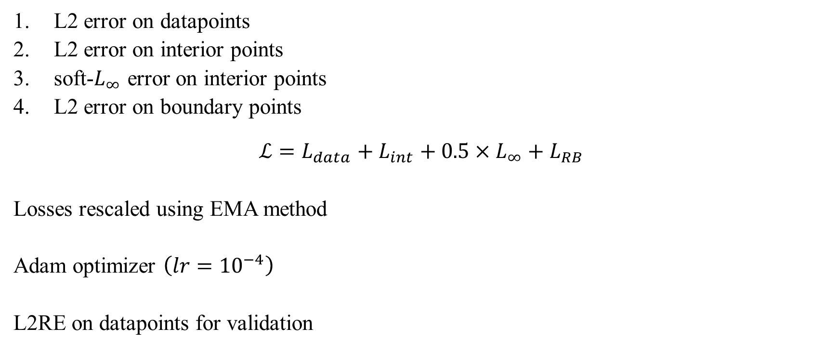
Loss function
L2 error on datapoints
L2 error on interior points
soft-$L_{∞}$ error on interior points
L2 error on boundary points
$$ℒ=L_{data}+L_{int}+0.5×L_{∞}+L_{RB}$$
Losses rescaled using EMA method
Adam optimizer $\left(lr={10}^{−4}\right)$
L2RE on datapoints for validation

Slide 17
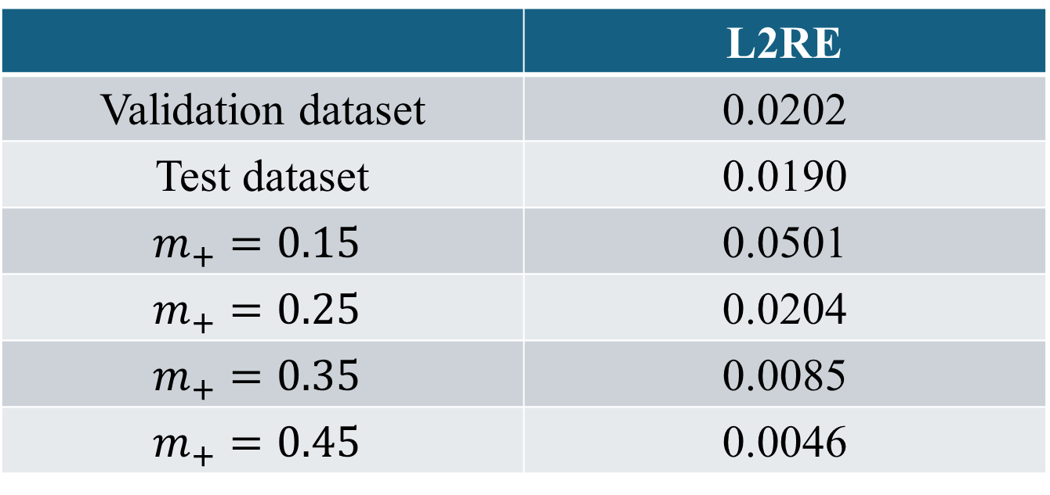
Results
Trained for 2734 epochs (8 hours 20 minutes on A100 GPU)
 | L2RE
Validation dataset | 0.0202
Test dataset | 0.0190
$$m_{+}=0.15$$ | 0.0501
$$m_{+}=0.25$$ | 0.0204
$$m_{+}=0.35$$ | 0.0085
$$m_{+}=0.45$$ | 0.0046

Slide 18
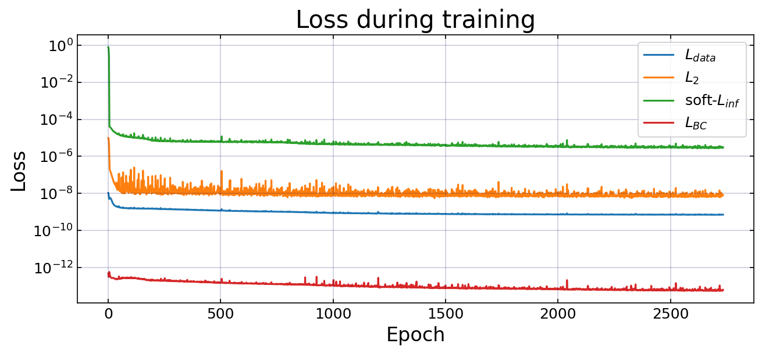
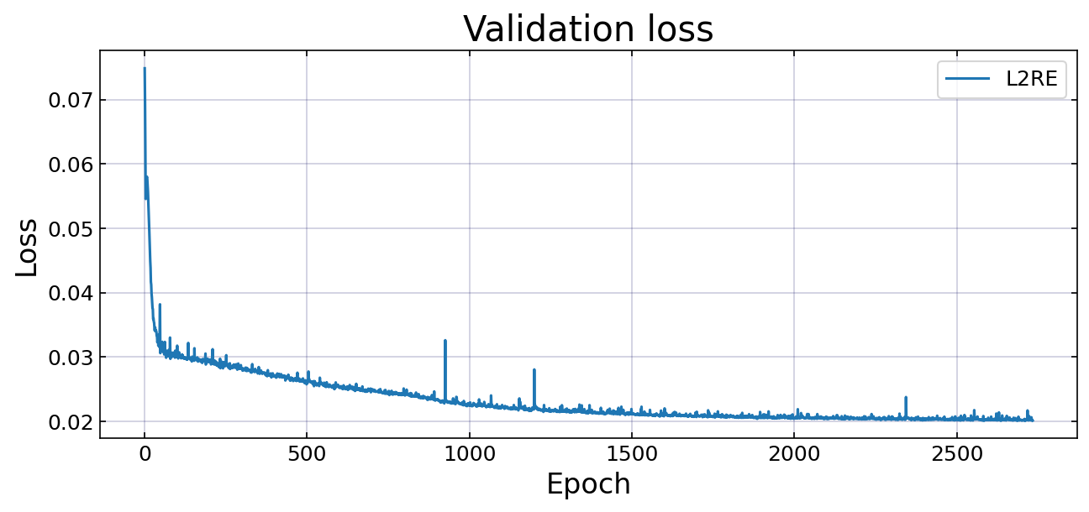
Loss graphs

Slide 19
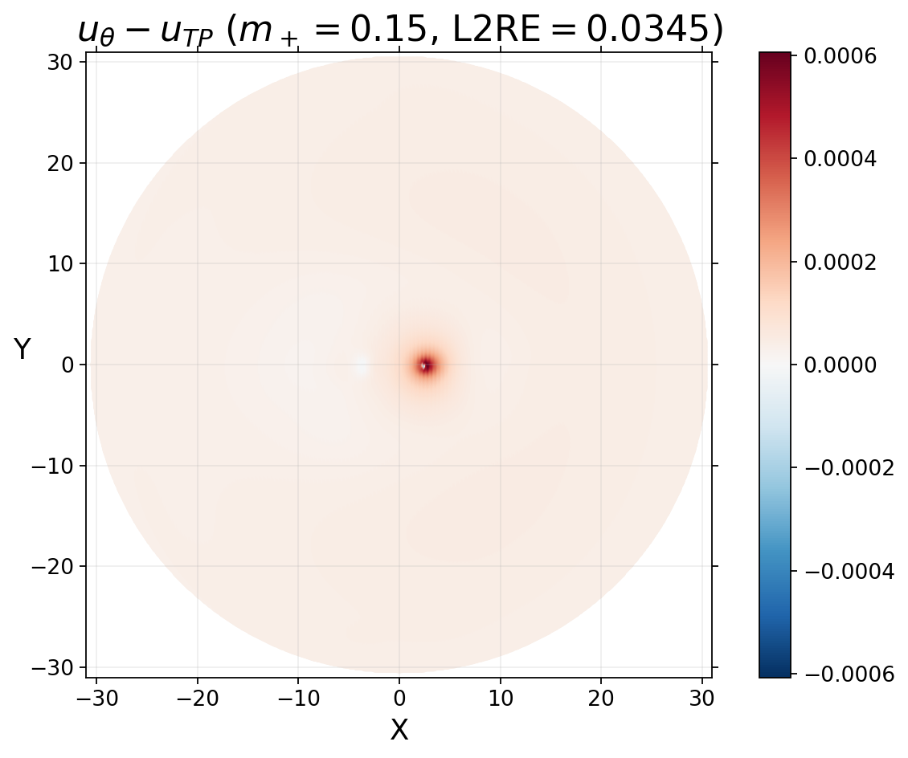
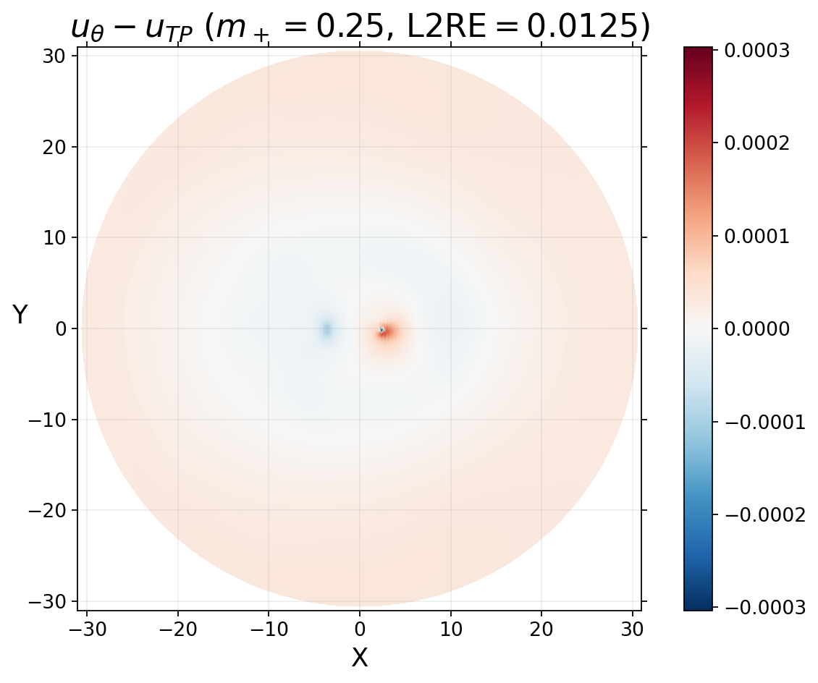
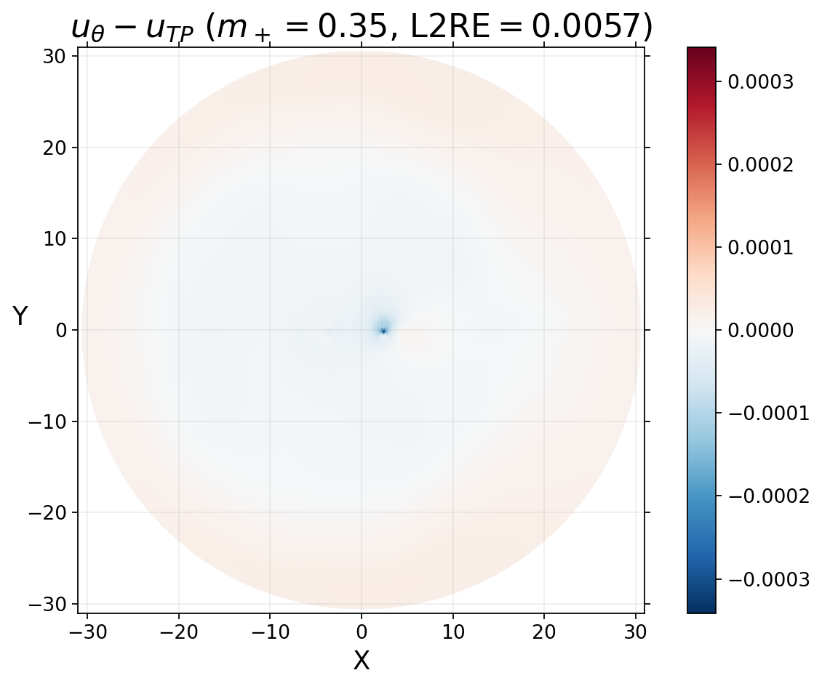
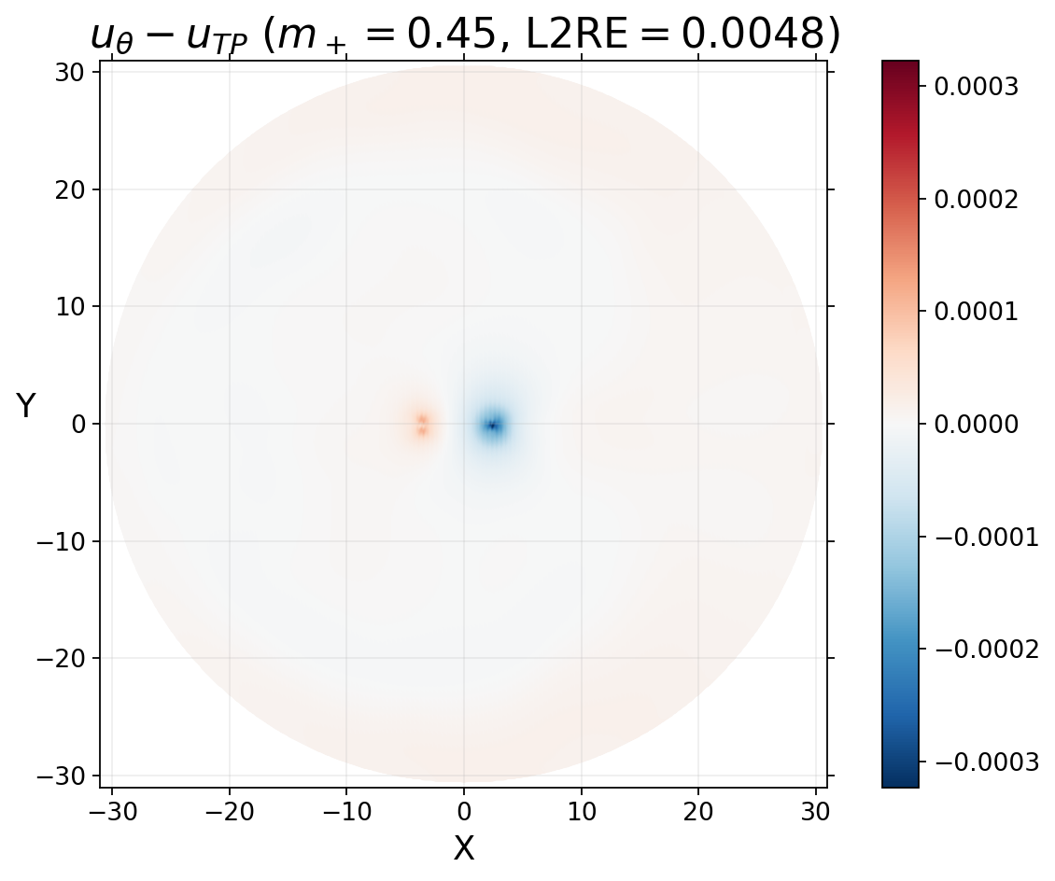
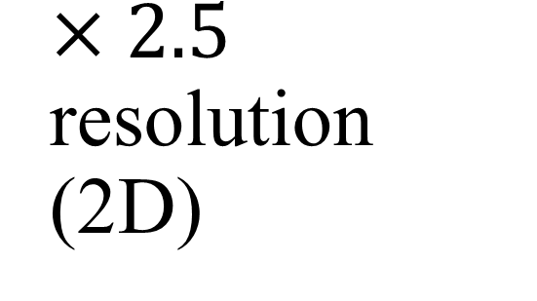
$×2.5$ resolution (2D)

Slide 20
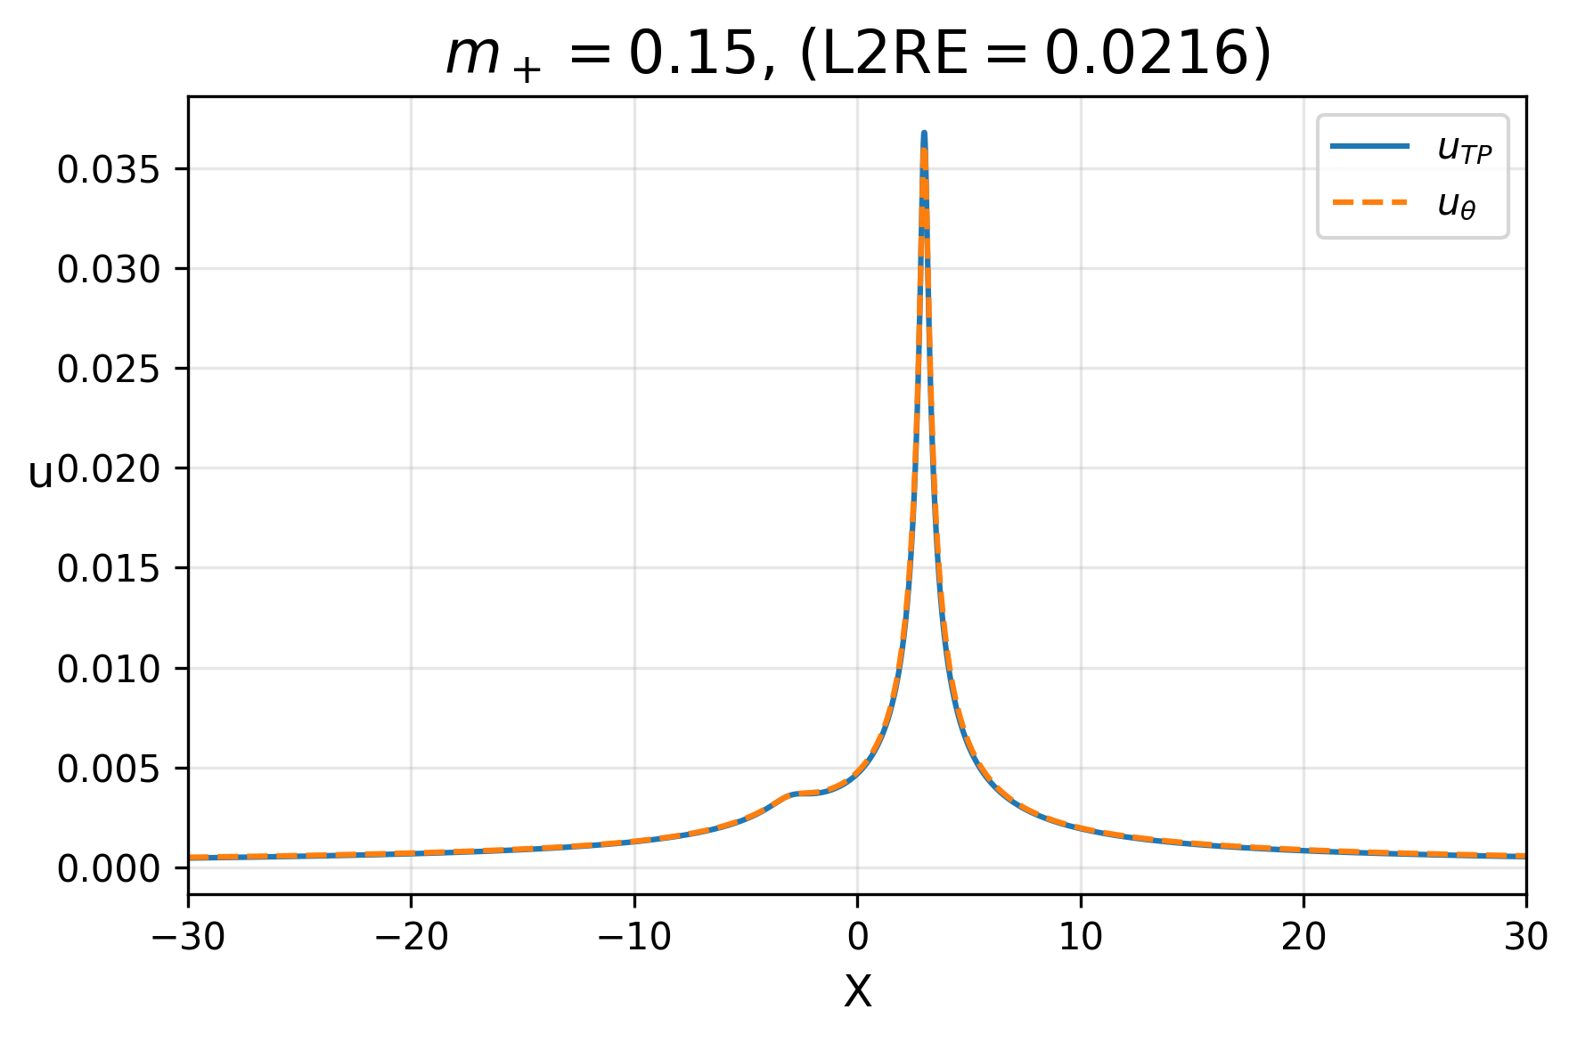
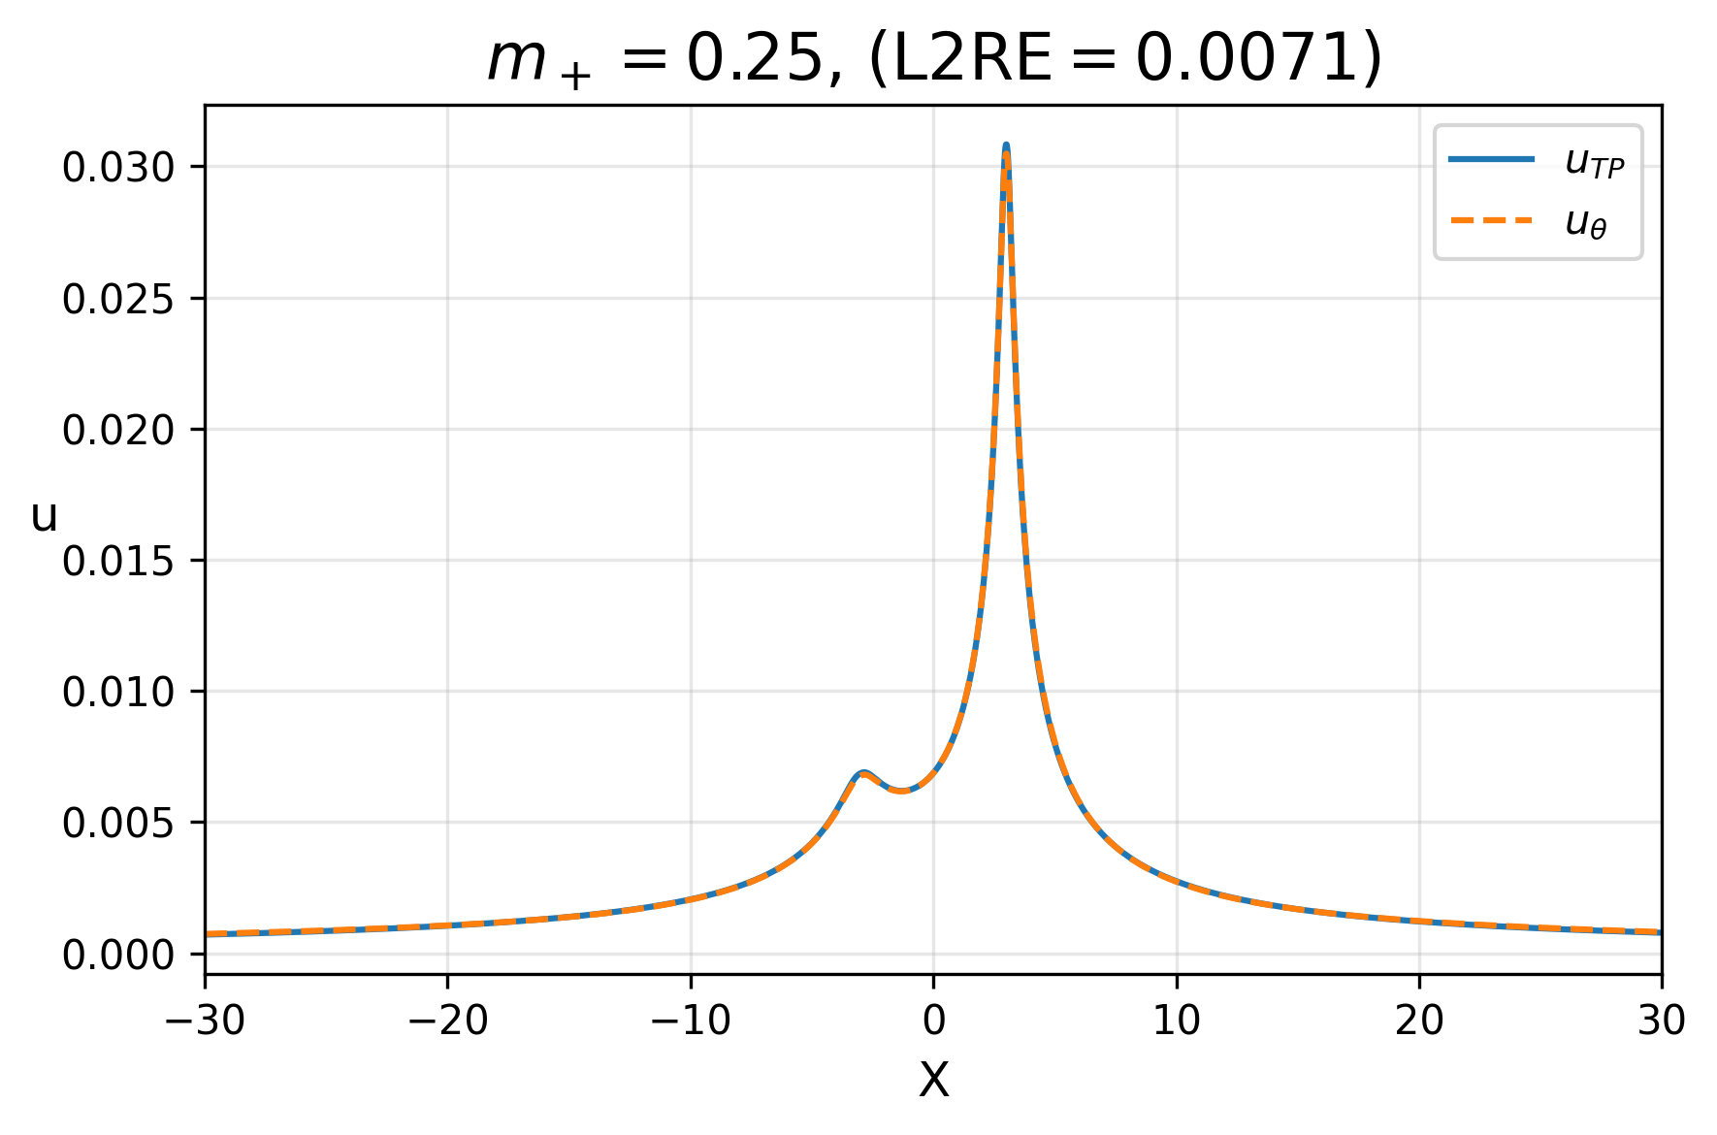
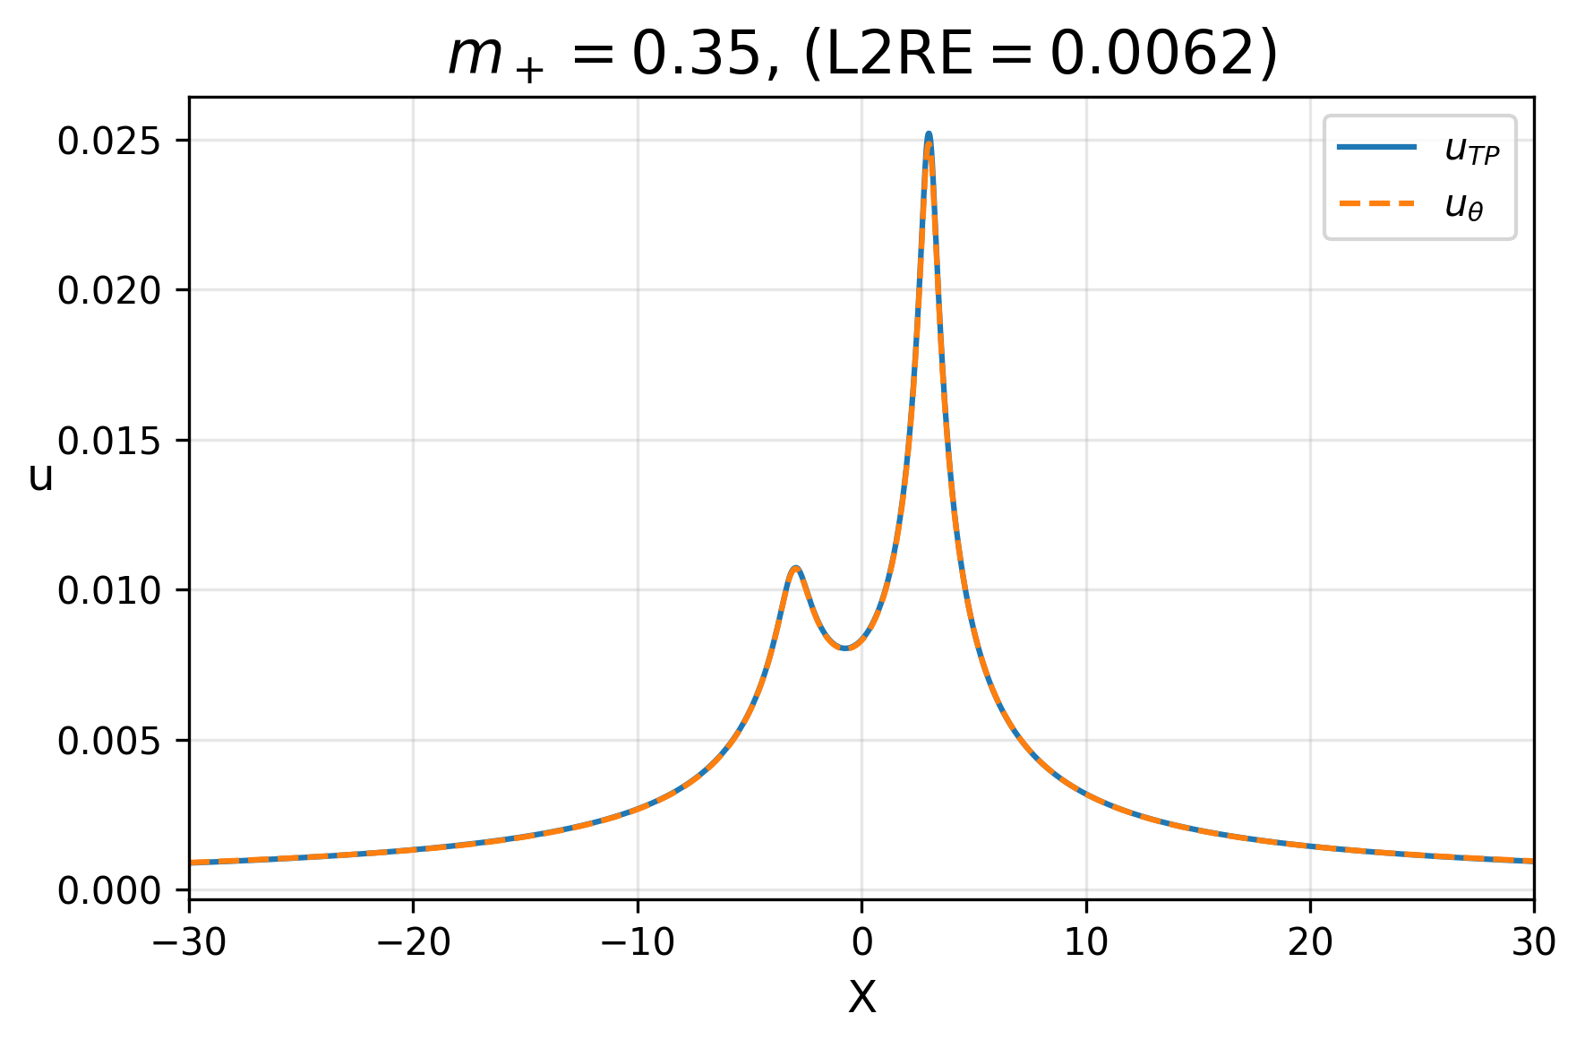
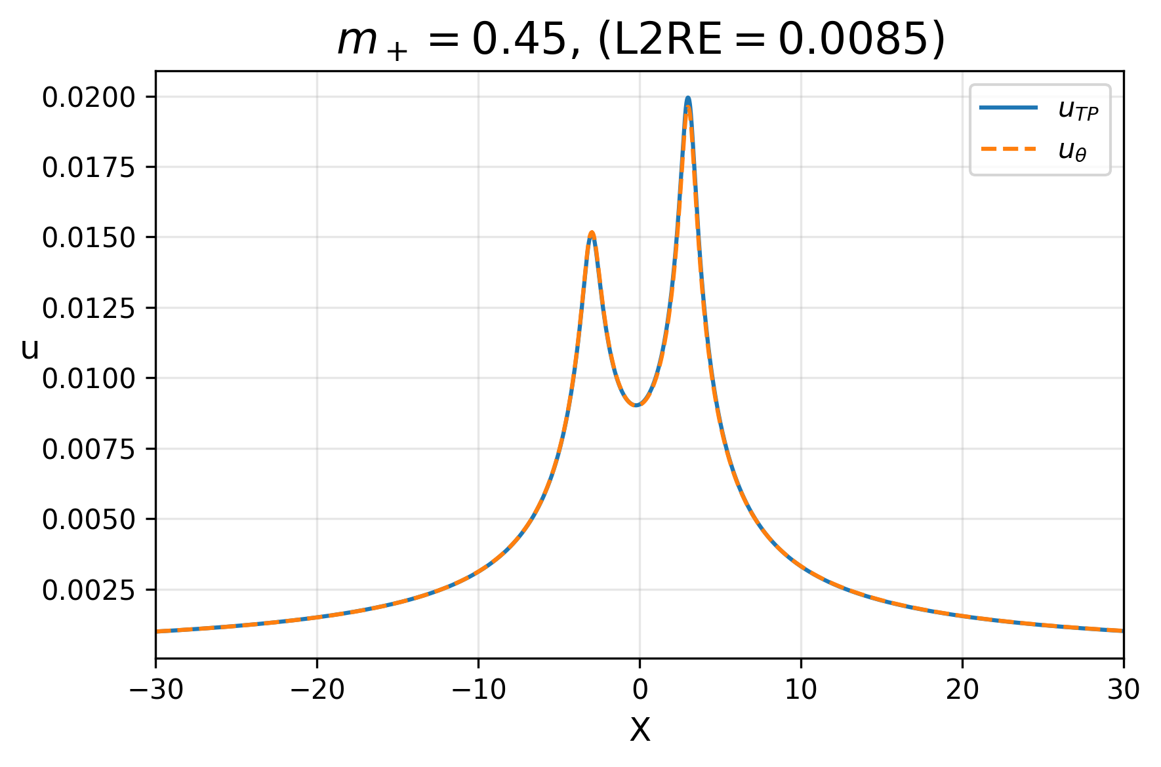
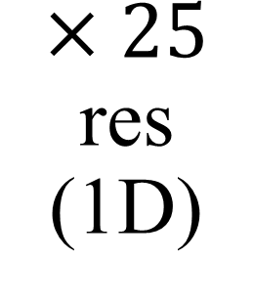
$×25$ res (1D)

Slide 21
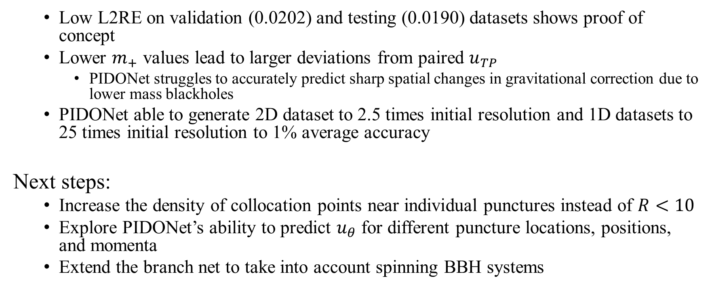
Conclusion
Low L2RE on validation (0.0202) and testing (0.0190) datasets shows proof of concept
Lower $m_{+}$ values lead to larger deviations from paired $u_{TP}$
PIDONet struggles to accurately predict sharp spatial changes in gravitational correction due to lower mass blackholes
PIDONet able to generate 2D dataset to 2.5 times initial resolution and 1D datasets to 25 times initial resolution to 1% average accuracy
Next steps:
Increase the density of collocation points near individual punctures instead of $R<10$
Explore PIDONet’s ability to predict $u_{θ}$ for different puncture locations, positions, and momenta
Extend the branch net to take into account spinning BBH systems

Slide 22
Thank you for listening

